Slide 1
B-4: DUST COLLECTOR USING MOBILE DUSTBIN
NAME | ROLL NO | GR NO
Himanshu Pandey | 23 | 11810912
Abhishek Hawaldar | 22 | 11810931
Abhijit Gawai | 19 | 11810895
Saumitra Godbole | 20 | 11810945
Hanzala Jamshed | 21 | 11811237
Prashil Jambhulkar | 24 | 11810849

Slide 2
Need for the project
In today’s world waste collection has become an important issue.
One of the most important part of this is collection of dust and other particle matter which cannot be collected manually.
Moreover this form of waste has become more prominent in today’s pollution ridden world .
Hence we have come up with a solution for the problem of dust collection through our project.

Slide 3
COMPONENTS USED
Arduino Nano Board
L293d Dual Motor driver H-BRIDGE Module
HC-05 Serial Port/TTL Bluetooth Module 3.3V/50mA DC supply.
BATTERY: -12V /1.3Ah rechargeable battery X(1)
-9v battery/170 mAh at 0.5A discharge X(2)
MOTOR: -150rpm 12v motor/ Torque:2kgcm X(2)
-3000rpm motor X(1)
WHEELS: -Swivel round ball caster wheel(11mm diameter). X(1)
-6.4 cm diameter wheels X(2)

Slide 4
Working Mechanism
The machine consists of a vaccum suction part which sucks the dust from the opening near the surface.
The base consists of motors and wheels which provides mobility to our vacuum part.
The mobile part of the project is connected to a Bluetooth device. The Bluetooth module can be connected to our android phones. To receive and transmit signal.
The vaccum part of the machine is detachable so that the waste collect can be disposed with ease.

Slide 5
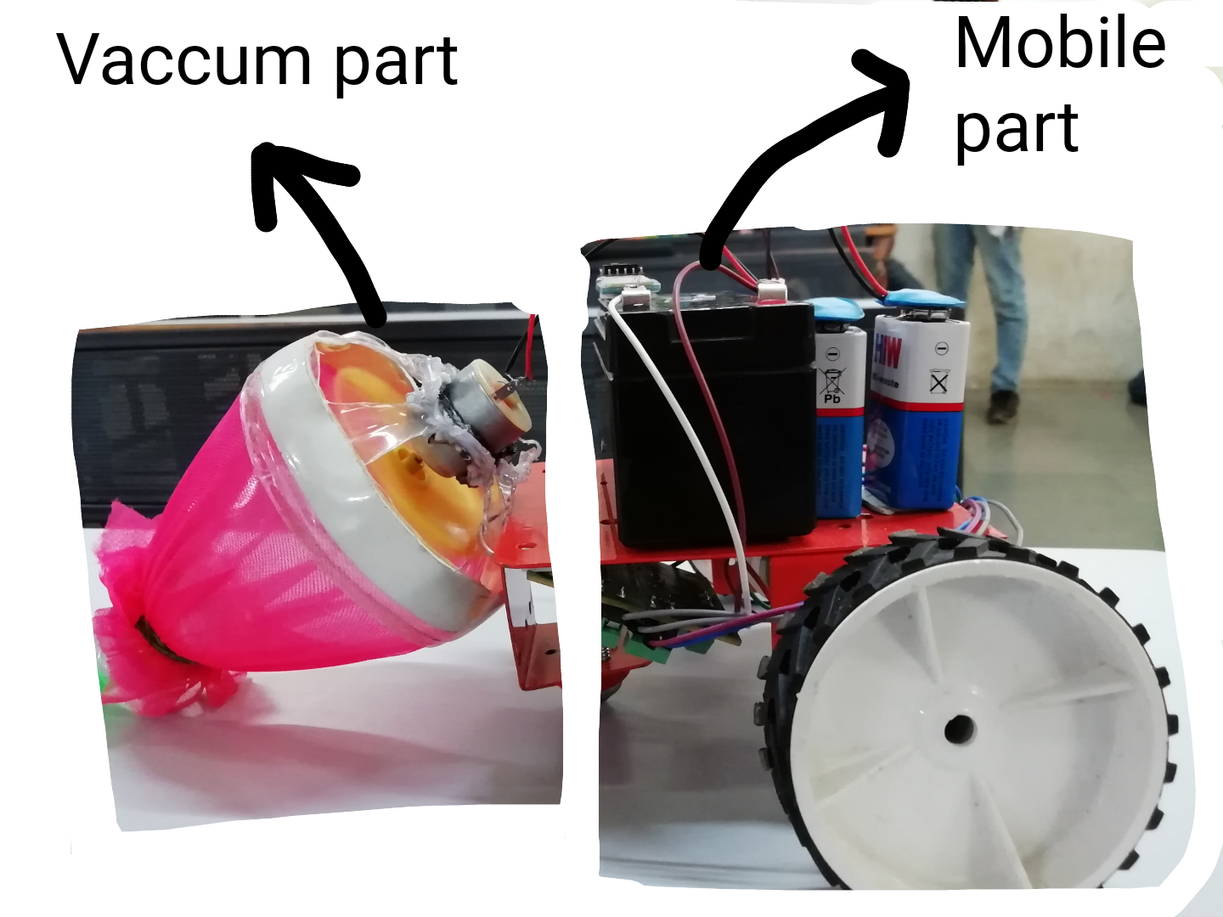

Slide 6
Pseudo Code
//Coding done on Arduino IDE.
int pwm1=100,pwm2=0; #define motor1 3 #define motor2 5 #define motor3 7 #define motor4 9 #define motor5 2 void setup() { pinMode(motor1,OUTPUT); pinMode(motor2,OUTPUT); pinMode(motor3,OUTPUT); pinMode(motor4,OUTPUT); pinMode(motor5,OUTPUT); Serial.begin(9600); } void loop() { digitalWrite(motor5,HIGH); if(Serial.available()>0) { char t=Serial.read(); if (t=='F')
{analogWrite(motor1,pwm1); analogWrite(motor2,pwm2); analogWrite(motor3,pwm2+50); analogWrite(motor4,pwm1);} else if (t=='L') {analogWrite(motor1,pwm1); analogWrite(motor2,pwm2); analogWrite(motor3,pwm2+50); analogWrite(motor4,pwm2+50); } else if (t=='R') {analogWrite(motor1,pwm2); analogWrite(motor2,pwm2); analogWrite(motor3,pwm2+50); analogWrite(motor4,pwm1);} else if (t=='B') {digitalWrite(motor1,LOW); digitalWrite(motor2,LOW); digitalWrite(motor3,LOW); digitalWrite(motor4,LOW);} else if (t=='S’) {analogWrite(motor1,pwm2); analogWrite(motor2,pwm2); analogWrite(motor3,pwm1); analogWrite(motor4,pwm1);} } }

Slide 7
ADVANTAGES DRAWBACKS
Easy to use
Time saving
Efficient method of dust collection
Economical
It is compact.
Limited dust storage capacity.
Dust should be disposed frequently.
Works only on even surfaces.
Limited to small particles

Slide 8
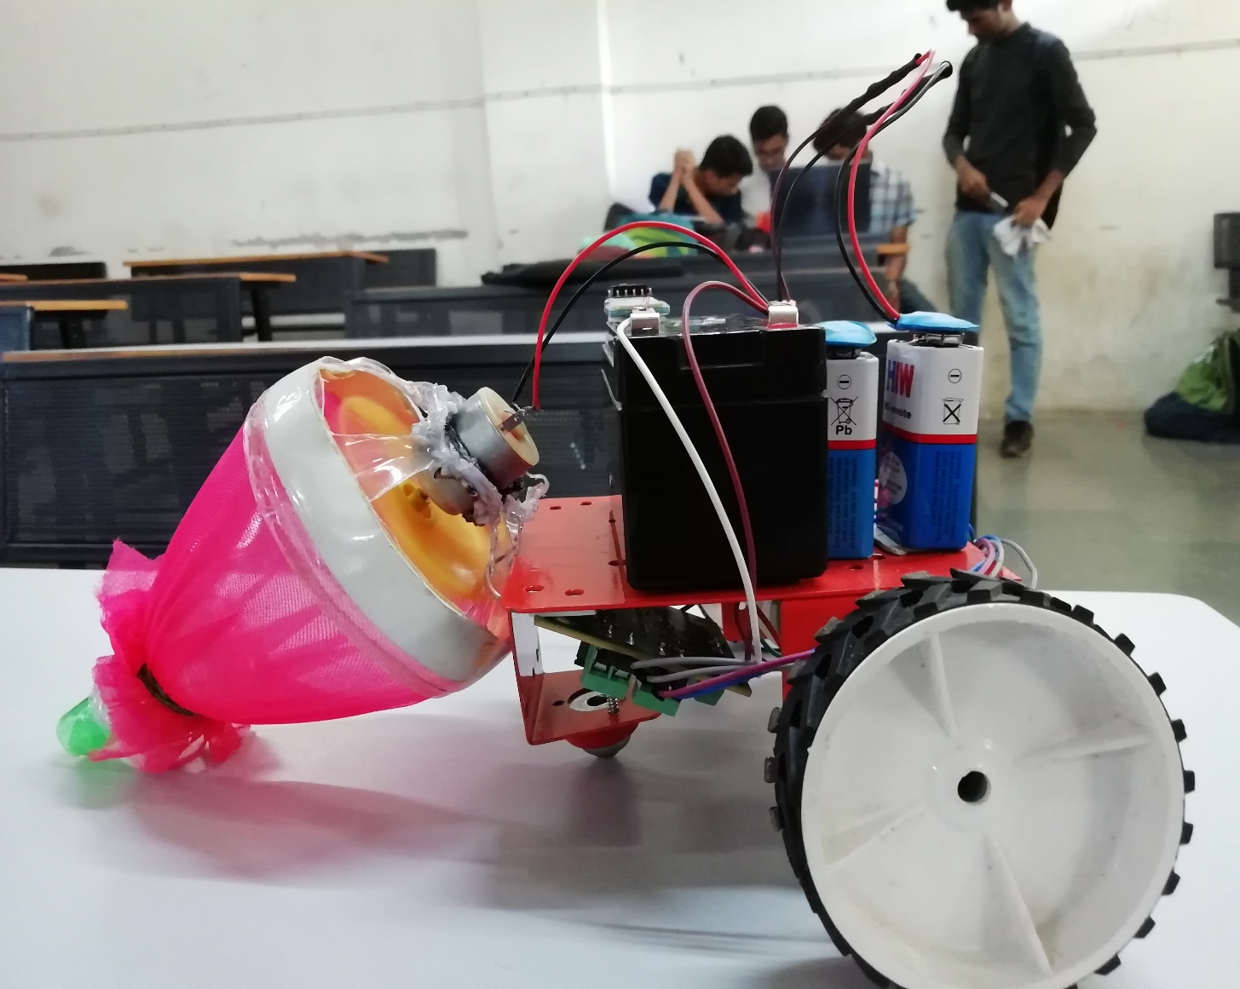

Slide 9
FUTURE SCOPE
We can use Wi-fi module instead of Bluetooth module, to increase the range.
We can make it automatic instead of manual control.
We can increase storage capacity.
We can increase the suction power so that it will suck bigger particles.

Slide 10
EXPENDITURE
S NO. | COMPONENTS | UNIT COST (in Rs.) | QUANTITY | TOTAL AMOUNT (in Rs.)
1 | ARDUINO NANO | 270 | 1 | 270
2 | MOTOR DRIVER | 250 | 1 | 250
3 | BLUETOOTH MODULE | 235 | 1 | 235
4 | BATTERY --12V RECHARGEABLE --9V BATTERY | 200 25 | 1 2 | 200 50
5 | MOTOR --12V 150 RPM MOTOR --5V 3000 RPM MOTOR | 180 30 | 2 1 | 360 30
6 | WHEELS --CASTER WHEELS --6.4 cm DIAMETER | 10 15 | 1 2 | 10 30
7 | WIRES AND OTHERS | ----- TOTAL | ------- EXPENDITURE | __________50 1485

Slide 11
ACKNOWLEDGEMENT
We would like to express our gratitude to the director Dr. Jalnekar Sir. Also we would like to thank our guide for the project Prof. Harshavardhan Khare for giving us the opportunity to do this project of “dust collection using mobile dustbin” which has helped us in getting valueable real life experience .

Slide 12
THANK YOU

